Slide 1
Navigating the Intersection: Western Water, Climate Change, and Public Health
October 26, 2016

Slide 2
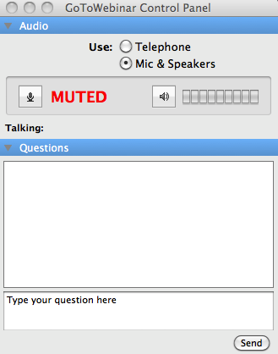
Q&A Instructions
Q&A will follow the presentations. We welcome you to submit your questions at any time using the chat box on your GoToWebinar control panel.

Slide 3
Carpe Diem West
We catalyze successful efforts around the American West to multiply their impact, tell the stories of successful source water protection work, spread these innovative approaches, and incorporate water justice and equity into the fabric of western water management.

Slide 4
AGENDA
1
Introduction - Carpe Diem West & Water is Life Kimery Wiltshire
2
Health Impacts – Western Water and Climate Change Dr. Linda Rudolph
3
Salt Lake City – Vulnerabilities and the Unexpected Laura Briefer
4
Participant Poll
5
Q&A Dr. Tracy Delaney
6
Where do we go from here?

Slide 5
Water is Life
Clean and accessible water is critical to public health. Current climate change indicators make it clear we must immediately start cross-sectoral dialogues , representing all potentially impacted constituencies, in order to prepare health workers and the communities they serve for every eventuality.
Elise Miller, Executive Director, Collaborative on Health and the Environment

Slide 6
Water is Life Resources
New Infographic
Western Water, Climate Change, Public Health & Equity
One-page Program Overview
Presents the problem, explains the program, and outlines anticipated outcomes
Program Webpage
www.carpediemwest.org/water-is-life

Slide 7
Speakers & Moderator
Dr. Linda Rudolph
Laura Briefer
Dr. Tracy Delaney
Director, Center for Climate Change and Public Health’s Public Health Institute
Director, Salt Lake City Department of Public Utilities
Executive Director, Public Health Alliance of Southern California

Slide 8
Climate Change, Water, and Health
Linda Rudolph, MD, MPH
Carpe Diem West
October 26, 2016

Slide 9
Water is essential for life. Water is a human right.
2012 California Human Right to Water bill
“…every human being has the right to safe, clean, affordable, and accessible water adequate for human consumption, cooking, and sanitary purposes.”

Slide 10
What do we use water for?
Sustain life
Stay hydrated
Grow food, fiber, trees
Sanitation and hygiene
Sewer systems
Wash hands, bodies, food, homes
Hydropower
Transportation
Aquatic and riparian habitat
Cultural and spiritual
Recreation
Aesthetics
Landscaping

Slide 11
Water for Life
Sufficient: 50 - 100 liters of water per person per day
Safe: free from micro-organisms, chemical substances and radiological hazards
Acceptable: color, odor and taste
Accessible: water source within 0.6 mi of home and collection time < 30 minutes
Affordable: < 3 per cent household income.
http://www.un.org/waterforlifedecade/human_right_to_water.shtml

Slide 12
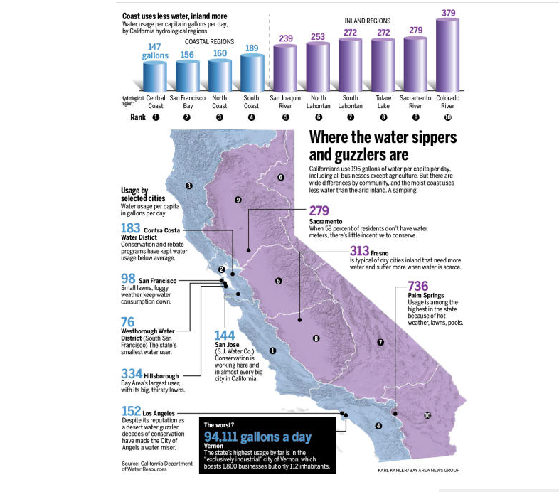
Africa Average
5 gpcd
USA Average
100-176 gpcd
http://www.mercurynews.com/science/ci_25090363/california-drought-water-use-varies-widely-around-state
Notes:
What impacts water use
Rainfall, temperature and evaporation rates
Vary need for water to maintain landscapes
Population growth
Increases overall demand
But new homes more water efficient
Population density
Highly urbanized areas – less landscaped area per person - use less water per person
Socio-economic measures (e.g. lot size, income)
Higher income areas generally use more water
Less sensitive to water costs – smaller portion of household income
Larger lots with more extensive landscaping
Water prices
Rate structures to incentivize conservation
Impacts on lower income
Infrastructure
Entitlements, Policies, Laws
https://drinc.ca.gov/dnn/Applications/UrbanWaterR-GPCD.aspx

Slide 13
California is not a developing nation, but…..
~ One million Californians lack reliable access to safe, affordable drinking water
Water systems serving largely Latino, low-income communities have disproportionately high arsenic, nitrate contamination
Residents paying up to 10% monthly income for clean, safe water
Globally:
Over 1 billion people without safe and adequate water supply
Up to 3.5 million deaths associated with inadequate water and sanitation
Climate change increases high water stress
http://d3n8a8pro7vhmx.cloudfront.net/communitywatercenter/pages/57/attachments/original/139439
4957/CWC-Law-Review-Article-on-Implementing-Human-Right-to-Water-in-CA.pdf?1394394957 http://www.huffingtonpost.com/entry/california-or-a-third-world-country_us_57c81ad4e4b078581f1129f5?riv4fz4ycf3b4kj4i

Slide 14
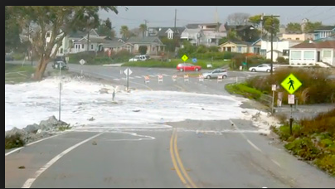
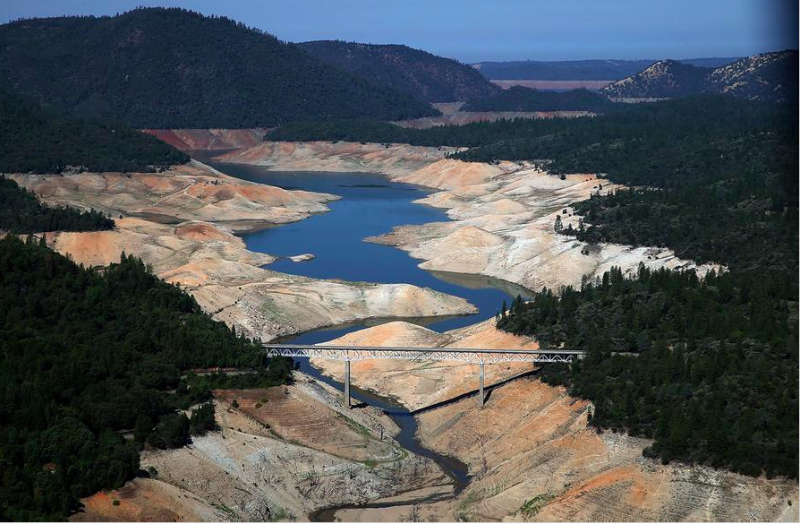
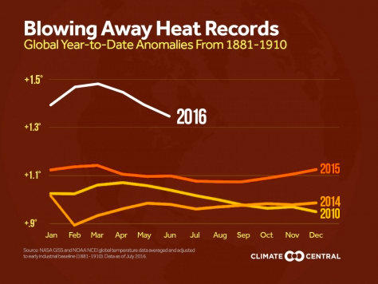
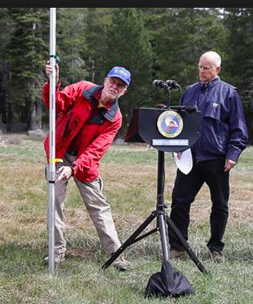
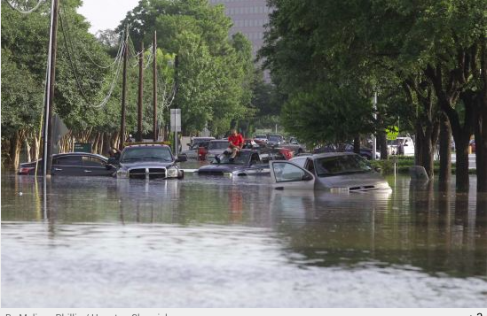
Climate change impacts on water in California
Drier Dries
Higher Highs
Hotter Hots
Reduced Runoff
Wetter Wets
Notes:
Projected increases in air temperature may lead to changes in the precipitation patterns, runoff timing and volume, sea level rise, and changes in the amount of irrigation water needed due to modified evapotranspiration rates
Spring runoff provides a significant portion of the water supply for dry summers and falls in California. Over the past 100 years, the runoff volume during April-July has decreased by 23% for the Sacramento basin (Figure 4) and 19% for the San Joaquin basin.
For California’s water supply, the largest effect of sea level rise (SLR) would likely be in the Sacramento-San Joaquin Delta (DWR, 2005a). Increased intrusion of salt water from the ocean into the Delta could lead to increased releases of water from upstream reservoirs or reduced pumping from the Delta to maintain compliance with Delta water quality standards.
While delivery is the key metric of performance in these studies, carryover storage can not be disregarded. Lower carryover storage indicates the projects are operating at a higher water supply risk. Also, lower carryover storage indicates lower head for hydropower production and less cold pool storage for fish protection.
250 mg/l maximum chloride concentration threshold for municipal and industrial intakes; 1) the types of operational changes that would be required to maintain chloride concentrations below the threshold for a 0.3m increase in sea level and 2) the subsequent water supply impacts of those operations changes for the SWP and CVP. For the sea level rise and combined climate change and sea level rise conditions, average chloride mass loadings increased by up to 11% due to increased salt intrusion from the ocean.
Increase direct runoff – flood potential?
http://springerlink.com/content/tk10720k416377j5/

Slide 15
What are the health impacts of climate-change impacts on water?
Water availability and cost
Water quality
Water and food production
Flooding
Infectious diseases
Water infrastructure
Mental health

Slide 16
Drought & Climate Change
Warming temperatures due to climate change
Larger fraction of mountain precipitation fall as rain rather than snow
Snowpack melts earlier due to warming
Reduced stream flows in late-spring, summer
More storm water lost to run-off vs soil absorption
Wildfires
Higher evaporation rates
Losses of water from reservoirs
Drier soil
Arctic ice loss may change the jet stream

Slide 17
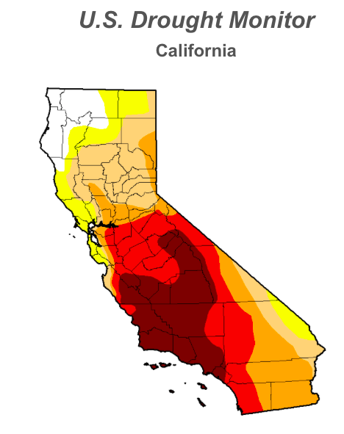
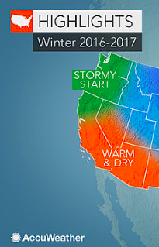
We are still in a drought…
October 18, 2016
http://www.accuweather.com/en/weather-news/2016-2017-us-winter-forecast-northeast-above-normal-snow-freeze-hurt-citrus-south/60277878
Notes:
Drought is a natural phenomenon in which rainfall is lower than average for an extended period of time, resulting in inadequate water supply.
Precipitation total in bottom 10% of average for 20th century
Reservoir total less than 70% average
http://www.cdc.gov/nceh/drought/
Impacted by:
Supply:
Surface water, groundwater, storage
Demand
Population growth
Diversification
Resource Management

Slide 18
Drought Health Impacts
Water Quality
Water Availability and Affordability
Food Costs and Insecurity
Vector-borne disease
Stagnant pools
Improper water storage
Wildfire
Air Quality
Increased dust and particulate levels
Increased pollen
Wildfire smoke
Recreational risks
Unemployment & economic impacts
Agriculture
Fisheries

Slide 19
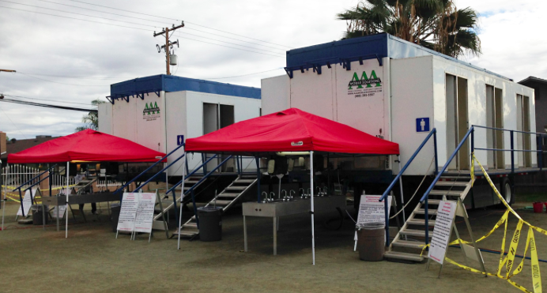
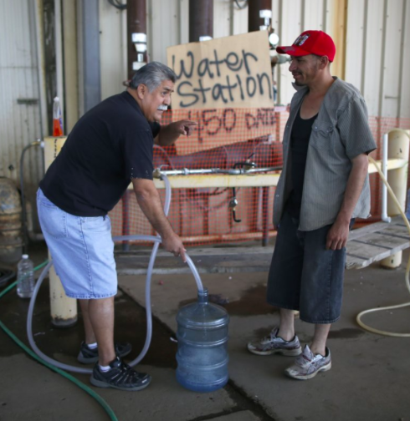
Water Quantity
Drought exacerbates problems with access to safe clean drinking water
Some communities reliant on vulnerable single source
Groundwater reliant on annual rainfall
Small systems reliant on stream flow
Thousands of Ca. households with no water due to drought

Slide 20
Water quality
Increase concentration of pollutants and contaminants in groundwater and surface water
Toxics and metals
Bacteria, protozoa, amoeba (warming and concentration)
Over 21 million Californians rely on contaminated groundwater as primary source of drinking water
Over 4 million people (especially in rural areas) highly vulnerable to groundwater contamination
Use of recycled water for food irrigation/processing may increase risks of E. coli and Salmonella
Clean-up of contaminated water very costly
Reduced stream and river flows : stagnation & low O2 levels

Slide 21
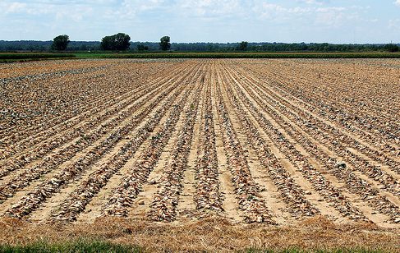
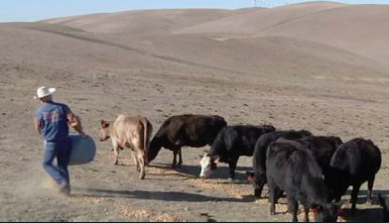
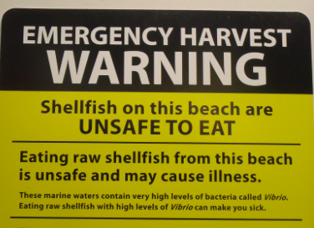
Drought and Food
Reduced yields due to shorter growing season, crop loss or fallowing
Conditions that encourage insect and disease infestation in some crops
Low crop yields can result in rising food prices and shortages,
Food insecurity associated with diabetes, obesity.
Affects health of livestock & cost of feed
Herd culling can increase meat and dairy prices
Impacts on fisheries
Harmful algal blooms, pathogens
Notes:
Limits in growing season
Reduced yields due to crop loss or fallowing
Conditions that encourage insect and disease infestation in some crops
Low crop yields can result in rising food prices and shortages,
Food insecurity associated with diabetes, obesity.
Affects health of livestock and cost of feed
Herd culling can increase meat and dairy prices

Slide 22
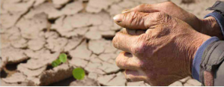
Drought and Mental Health
Drought stress may be different than stress in other disasters
Extended event, chronic, not viewed externally as “disaster”
Impact is worst for already stressed farm families and communities
Drought and suicide
Australia, US Midwest
http://www.health.vic.gov.au/pcps/downloads/planning_practice_guide.pdf http://farmprogress.com/story-nl13_3nl/drought-has-toll-farmers-mental-health-0-63892

Slide 23
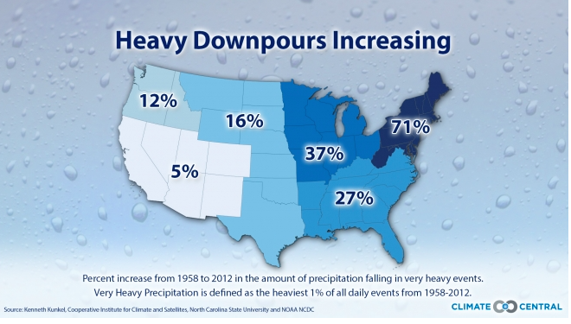
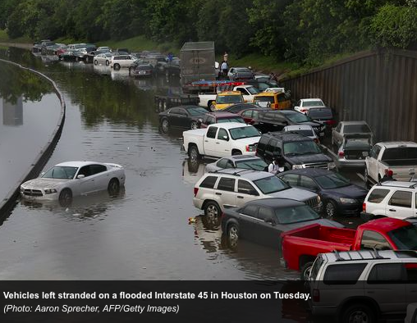
Extreme Precipitation & Flooding
Warmer air holds more moisture
Rain falling in more concentrated episodes
Risk: overwhelm capacity of
Combined sewer systems
Water treatment facilities

Slide 24
Public Health Issues - Precipitation
Extreme Precipitation
Overwhelm capacity of
Combined sewer systems
Water treatment facilities
Increased runoff: sediment, contaminants, nitrate, etc.
Contamination of surface and groundwater
Physical injuries and destruction of property
Waterborne disease outbreaks from drinking water or recreational contact : Giardiasis, E coli, Cryptosporidium
Notes:
Precipitation, especially extreme precipitation events, can cause a number of public health issues, including physical injuries, destruction of property and waterborne disease outbreaks. This diagram demonstrates how heavy downpours can lead to increased sediment in runoff as well as sewage overflows which can cause outbreaks of waterborne diseases such as Giardiasis, E coli, and Cryptosporidium. Waterborne diseases can contaminate drinking water and endanger beachgoers.
Sources:
(Climate Institute, 2010; Curriero et al. 2001; Ebi et al. 2008; Field et al. 2007; Karl et al. 2009; U.S. Climate Change Science Program, 2008)

Slide 25
Flooding Health Effects
Acute injuries & fatalities
Contamination: toxics and increased pathogen loads
Overload/failure of treatment facilities
Drinking water - waste water - sewage
Aging infrastructure
Mental health impacts
Disruption social networks & support
Respiratory illness
Disruption in medications
Soil erosion/loss

Slide 26
Waterborne Disease Outbreaks in U.S.
Inadequate, interrupted, or intermittent water treatment associated with waterborne disease outbreaks
½ of waterborne disease outbreaks from 1948 – 1994 associated with extreme precipitation
1993 Milwaukee Cryptosporidium Outbreak
1.61 M people were affected; over 400,000 w/ significant symptoms; 100 people died
Estimated number of waterborne illnesses/year: 19.5 M/yr. all health outcomes
http://www.ncbi.nlm.nih.gov/pubmed/18020305

Slide 27
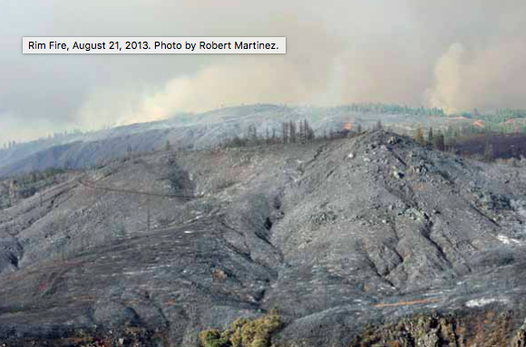
Wildfire & Water
Fire suppression/retardants
Less soil absorption post-fire
More erosion, ash, debris
Negative impacts on drinking water source quality

Slide 28
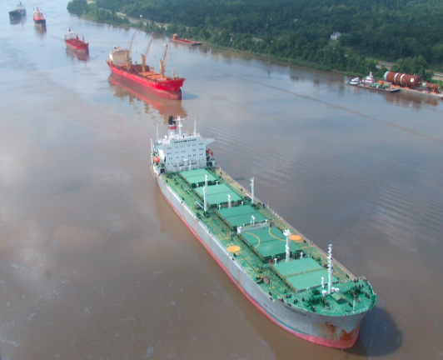
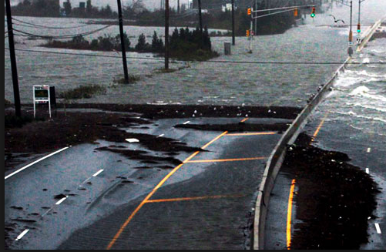
Transportation Impacts

Slide 29
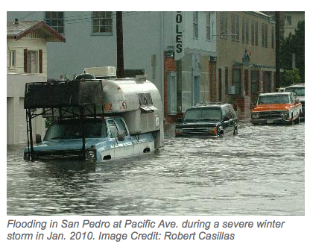
Sea Level Rise & Storm Surge
LA region sea level rise projected:
5 – 24 inches) from 2000 to 2050
17 – 66 inches from 2000 to 2100.
Saline intrusion
Sacramento-San Joaquin Delta
Roads, water systems, health facilities at risk
http://c-change.la/sealevelrise/

Slide 30
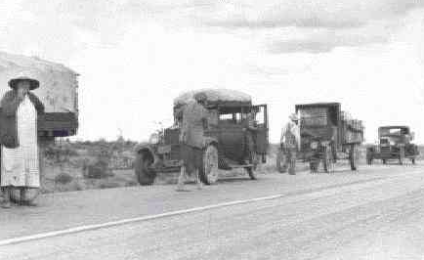
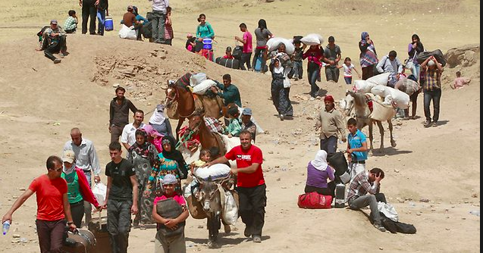
Displacement and Migration
Notes:
Risks related to water shortages, flood and other mechanisms involve large populations. Projections suggest, for example, that an additional 50 million people and 30,000 km² of land could be affected by coastal storm surges in 2100 with attendant risks of direct deaths and of infectious diseases.^{94,95} Involuntary displacement of populations, as a result of extreme events has major public health and policy consequences. In the longer term, flooding affects perceptions of security and safety, and can cause depression, anxiety and post-traumatic stress disorder.

Slide 31
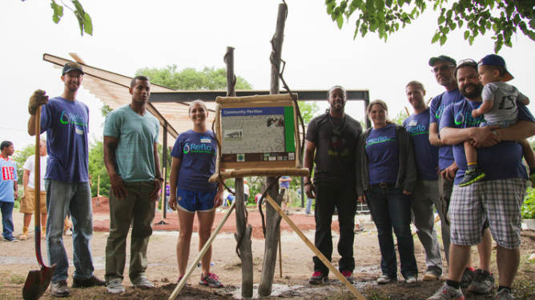
Public Health Roles
Sanitation and safe drinking water among great PH achievements of 20th century
Ensure access and promote safe drinking water
Schools & SSB
Monitor water quality
Encourage safe water recapture and re-use
Graywater
Rainwater harvesting
Support green infrastructure
Vulnerability assessment & integration into emergency planning
Incorporate water issues in nutrition education, healthy food procurement, food waste programs

Slide 32
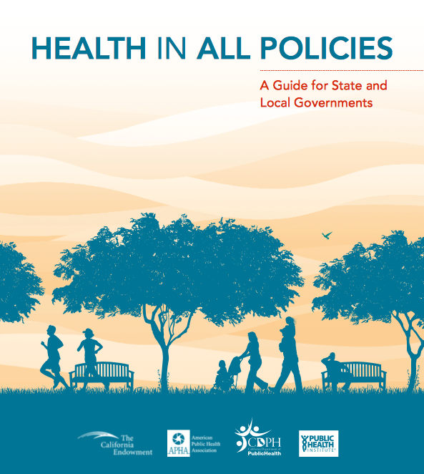
Transport
Industry
Water
Environmental Protection
Public Works
Housing
Agriculture
Land & Resources
Health
Energy
Public Safety
Education
Culture
https://www.apha.org/~/media/files/pdf/factsheets/health_inall_policies_guide_169pages.ashx

Slide 33
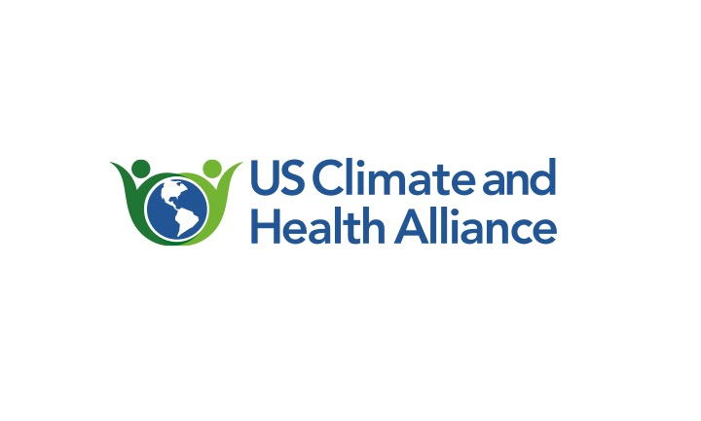
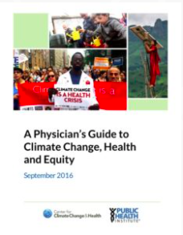
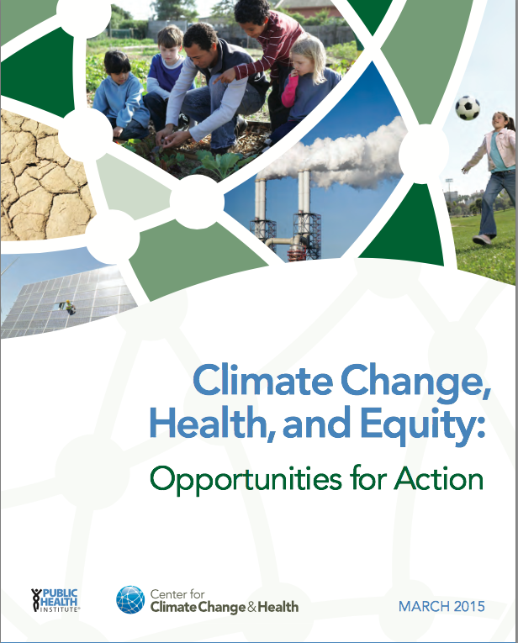
http://climatehealthconnect.org/
http://www.phi.org/uploads/application/files/h7fjouo1i38v3tu427p9s9kcmhs3oxsi7tsg1fovh3yesd5hxu.pdf
http://climatehealthconnect.org/resources/physicians-guide-climate-change-health-equity/

Slide 34
Water, Public Health, and Climate Change Salt Lake City’s Approach
Laura Briefer
Director, Salt Lake City Department of Public Utilities
October 26, 2016

Slide 35
Salt Lake City Department of Public Utilities
Public water supplier to 350,000 people
Stormwater and sewer service to 190,000 people

Slide 36
Salt Lake City’s Current Water Sources
Streams
Reservoirs
Groundwater

Slide 37
Intersection of Water, Climate, and Public Health
Clean water
Water availability
Current and future generations
Notes:
Access to clean water, and water availability are pressing global challenges, an have a direct nexus to human health. Even in the US, water quality and availability are challenging – much surface water needs treatment to be safe, groundwater is being depleted or contaminated, new contaminants are emerging, and future trends, such as climate change, present significant impacts and uncertainty associated with water quality and water supplies for future generations.
For local public water suppliers, such as Salt Lake City, recognizing and managing current and future water and public health challenges is critical. For this presentation, I wanted to share with you Salt Lake City’s approach and thinking to address these challenges.

Slide 38
Climate Change Vulnerabilities for Salt Lake City’s Water Resources
Precipitation change or uncertainty
Snowpack decrease
Earlier runoff timing
Decrease in water quantity
Increase in water demand
Water quality degradation
Drought intensification
Catastrophic fire
Notes:
Salt Lake City is now incorporating climate change into its long term water resource planning. We work with federal agencies and universities to identify likely water resource vulnerabilities specific to our system. For instance:
One study we conducted shows that our local Wasatch streams, our most important water resource, are sensitive to changes in temperature and precipitation. With every degree farenheit increase in temperature, we can expect to see close to a 3.8% average decrease in overall water volume emanating from the Wasatch streams.
We can expect to see the timing of peak runoff happening earlier, creating a gap between when the water flows from the mountains and when the higher water demands occur.
A decrease in our mountain snowpack, reducing the natural water storage of our system.
An increase in water demand due to warmer temperatures and plant needs,
Water quality degradation due to a number of climate-related factors; and
Longer and more intense droughts could challenge even the water resource redundancies we currently have in our water system.

Slide 39
Adaptation Strategy #1: Enhance Water Quality Protection
Use a “multi-barrier” approach for protecting water from pollution
Headwaters protection and management
Water treatment process
Distribution system
Water quality monitoring
Notes:
Source water protection
Water treatment
Distribution system
Water quality monitoring throughout the system
First barrier to prevent pollution = source water protection
Second barrier = water treatment process. We use conventional treatment given the high quality water.
Third barrier = maintain water quality in the distribution system
Fourth barrier = vigilant water quality monitoring

Slide 40
Salt Lake City’s Headwater Protection Model
Land Conservation $1.5 million/year from SLC water bills
Public Watershed Education and Engagement
Land Use and Water Supply Regulations
Public-private partnerships for monitoring, restoration, education
Watershed Restoration
Watershed Monitoring – water quality and land use

Slide 41
Adaptation Strategy #2: Adaptive Water Supply Management
Know water vulnerabilities
Engage the public
Account for uncertainties
Plan for short and long term time horizons

Slide 42
Salt Lake City’s Adaptive Water Supply Management Model
Diversify water sources
Monitor and model the water system and climate change impacts
Make decisions based on both seasonal and multi-year time scales
Improve and maintain infrastructure
Coordinate with other water agencies and governments
Make operational and policy changes
Notes:
Invested in a diversity of supplies from our streams, reservoirs, and groundwater
Actively monitor the system – weather, climate, models, water quality - monitored over decades and months
Proactive water resource management – take the data and understanding of the system to make proactive decisions about which sources we use, demand management, etc…
Seasonal and multi-year decision – we look at each decision, for instance how much stored water to use, for both this season, but also for multiple years (in case of drought, and to build in redundancy.
Alignment of infrastructure improvements – Take care of infrastructure to protect public health. We integrate major infrastructure projects – treatment plants, aqueducts, distribution system into water resource management so that the infrastructure capacity is taken into consideration to water supply situation
Coordinate with other water agencies and governments. Aquifers and watersheds are shared, some infrastructure is shared. Metro, Sandy City, JVWCD, and others.

Slide 43
Adaptation Strategy #3: Expect (and learn from) the Unexpected
Summer 2016 unprecedented algal bloom on Utah Lake
Toxic algae posed significant health risk
Utah Lake source water could not be used for irrigation for two weeks
Notes:
Climate change, public health, and water have significant feedback loops
The event affected more than 2 million people directly and indirectly. Numerous federal, state, and local agencies were involved. Water utilities, farmers, refugee community, homeless, and water recreationists were affected. Opportunity for regional learning.

Slide 44
Thank You
Laura Briefer, MPA
Director
Salt Lake City
Department of Public Utilities
laura.briefer@slcgov.com

Slide 45
Participant Poll
Please take a moment to mark your responses

Slide 46
Q & A
with Dr. Tracy Delaney

Slide 47
Program Outcomes
Core leadership group is established
Convening of field leadership identifies opportunities for cross-sector work, policies, action steps and priority research needs
Outcomes from the convening are developed to the next steps
One to two years of funding is secured
Water is Life work is housed at an appropriate institution

Slide 48
Speakers & Moderator
Dr. Linda Rudolph
Laura Briefer
Dr. Tracy Delaney
Director, Center for Climate Change and Public Health’s Public Health Institute
Director, Salt Lake City Department of Public Utilities
Executive Director, Public Health Alliance of Southern California

Slide 49
Post-webinar Survey & Carpe Diem!
www.carpediemwest.org

Slide 50
CONTACT
209 Caledonia Street
Second Floor
Sausalito, California
94965
415-332-2112
info@carpediemwest.org

